Slide 1
LENOVO CUSTOMER ENQUIRY CALL ANALYSIS
RAGHU M

Slide 2
TABLE OF CONTENTS
Problem statement
Objective
Exploratory Data Analysis
Insights and Findings
Conclusion

Slide 3
PROBLEM STATEMENT
Analyze the contact center data (attached herewith) to understand the causes of customer calls and come up with recommendations on reducing call volumes and handling calls better to increase customer sales.
Conduct EDAs to analyze the data (including mining/analysis of text fields and inputs) and better understand call reasons and outcomes
Summarize your findings using appropriate visualizations.

Slide 4
OBJECTIVE
Understand the causes of customer calls
Recommendations on reducing call volumes
Handling calls better to increase customer sales

Slide 5
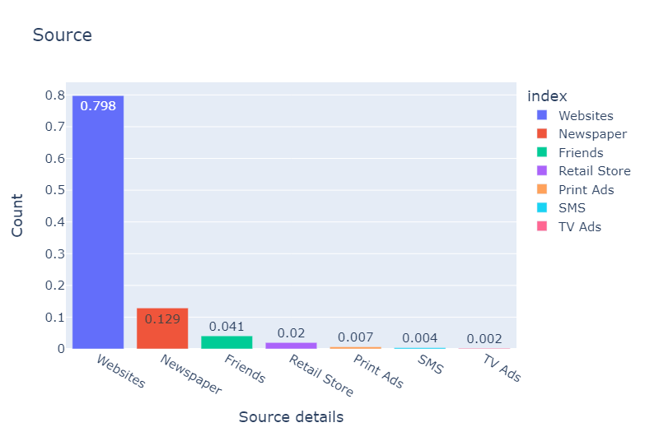
EXPLORATORY DATA ANALYSIS
Around `80%` of the customers depends on websites to reach out the Lenovo customer service team.

Slide 6
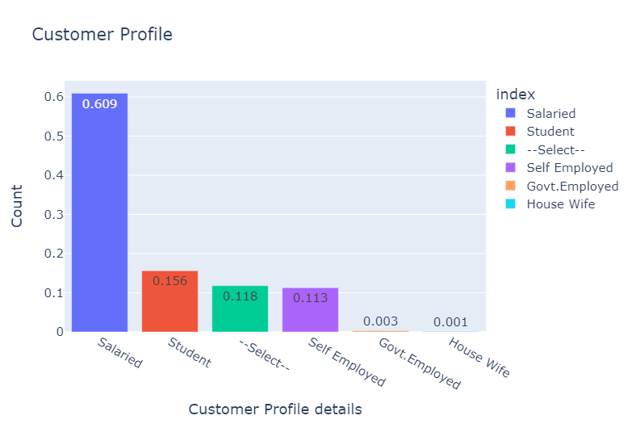
EXPLORATORY DATA ANALYSIS
`60%` of the customer enquiry calls are received from the `Salaried` customers

Slide 7
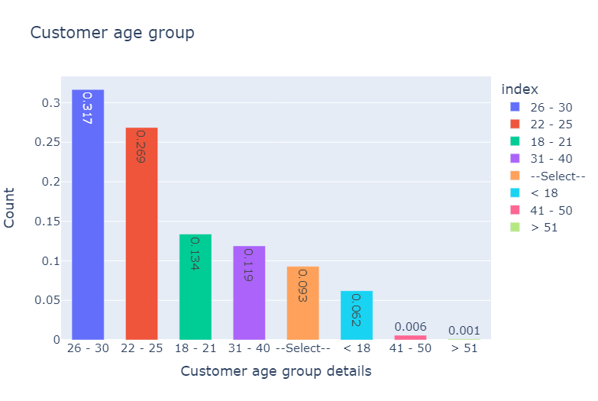
EXPLORATORY DATA ANALYSIS
~ `57%` of the customer enquiry calls are received from the `age group 22-30`

Slide 8
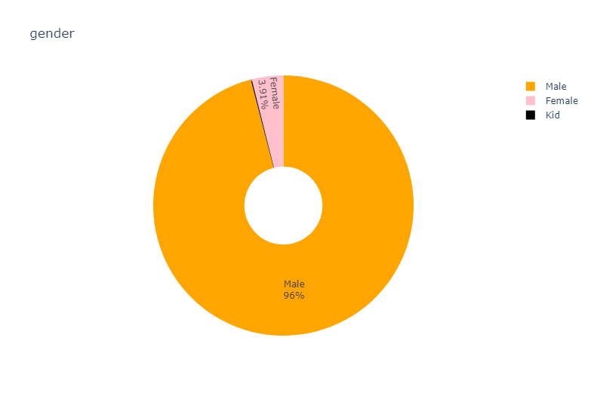
EXPLORATORY DATA ANALYSIS
`~96%` of the customer enquiry calls are received from the `male users`

Slide 9
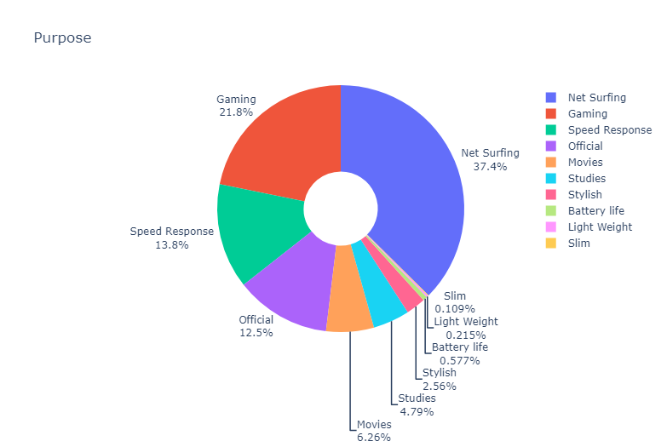
EXPLORATORY DATA ANALYSIS
37.4% of the customers are using our product for Net Surfing purpose.
21.8% of the customers are using our product for Gaming purpose
13.8% of the customers are reach out to the customer care because not good Speed Response from our products.
12.5% of the customers are using our product for Official purpose

Slide 10
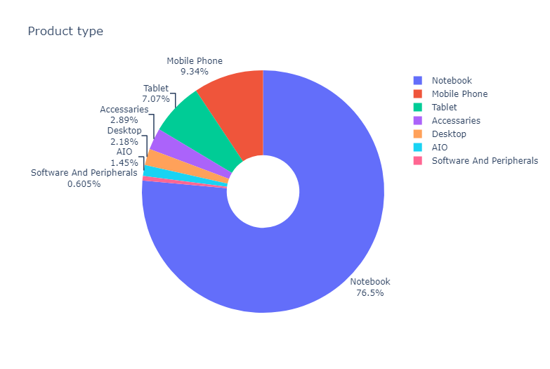
EXPLORATORY DATA ANALYSIS
~76.5% of the customer enquiry calls are received for the product Notebook
~9.34% of the customer enquiry calls are received for the product Mobile Phone
~7.07% of the customer enquiry calls are received for the product Tablet
Approximately 93% of the customer enquiry calls are received related to the products "Notebook, Mobile Phone and Tablet"

Slide 11
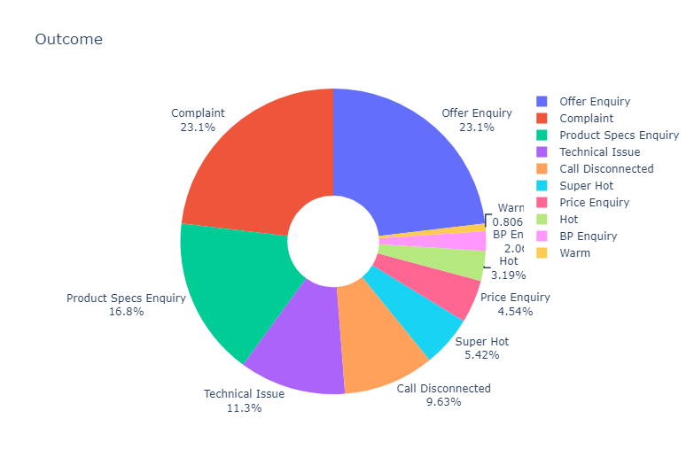
EXPLORATORY DATA ANALYSIS
Potential new buyers / new customers
22% of the customer enquiry calls related to Offer Enquiry
16% of the customer enquiry calls related to Product Specs Enquiry
~4.5% of the customer enquiry calls related to Price Enquiry
Approximately 42.5% of the call are from potential new buyers.
We can push more promotional users to this cluster of people to improve the sales

Slide 12
EXPLORATORY DATA ANALYSIS
Existing Customers/ existing our product users
22% of the customer enquiry calls related to inform Complaint.
~11% of the customer enquiry calls related to Technical Issue
~9% of the customers are facing heating issues in our product.
Approximately 42% of the call are from existing customers
~9% of the customer enquiry calls are not resolved in the first attempt due to Call Disconnected

Slide 13
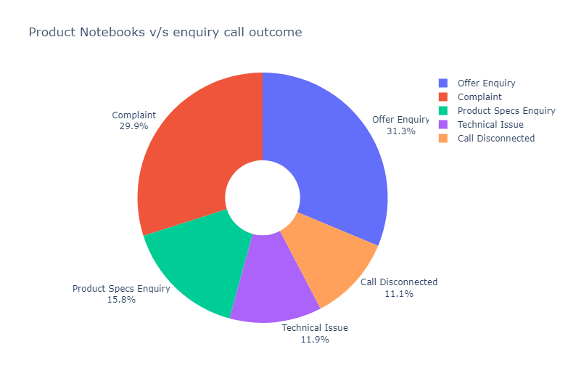
EXPLORATORY DATA ANALYSIS
23% of the customer enquiry calls related to the product Notebooks are not resolved in the first attempt
31% of the customer enquiry calls related to the offer enquiry of the product Notebook.
~30% of the customer enquiry calls related to the Complaint of the product Notebook.

Slide 14
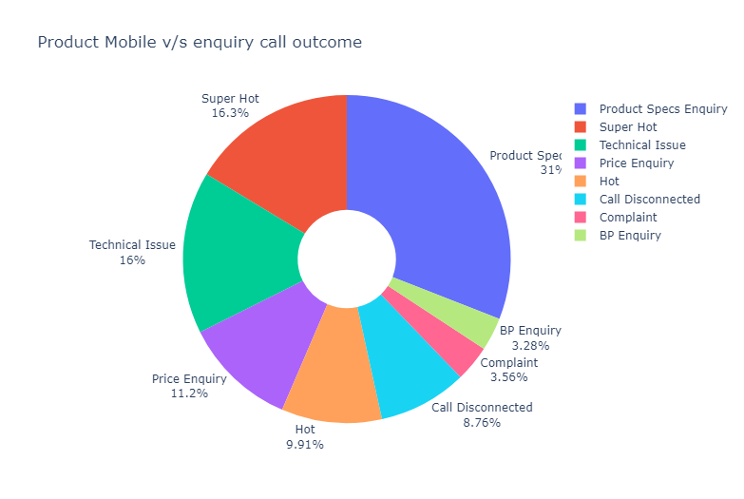
EXPLORATORY DATA ANALYSIS
26.21% of the customer calls are received for the overheating issue of the product Mobile phone
~31% of the customer calls are received for the spec's enquiry of the product Mobile phone
16% of the calls are related to technical issue in the product Mobile phone.

Slide 15
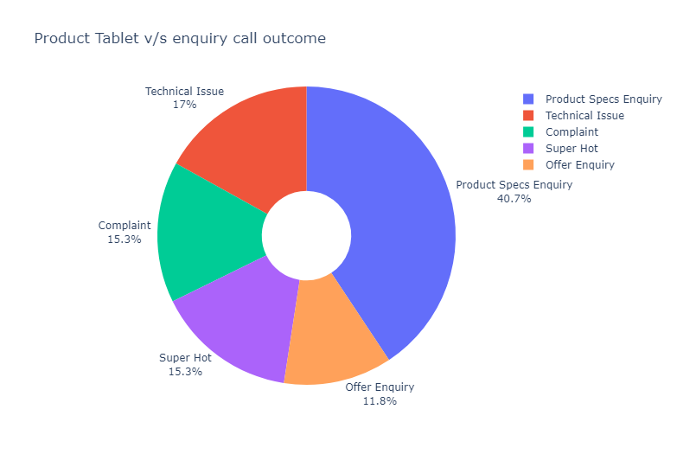
EXPLORATORY DATA ANALYSIS
~15% of the customer calls are received for the overheating issue of the product Tablet
~17% of the customer calls are received for the Technical issue of the product Tablet
~15% of the customer calls are received for the various complaint of the product Tablet

Slide 16
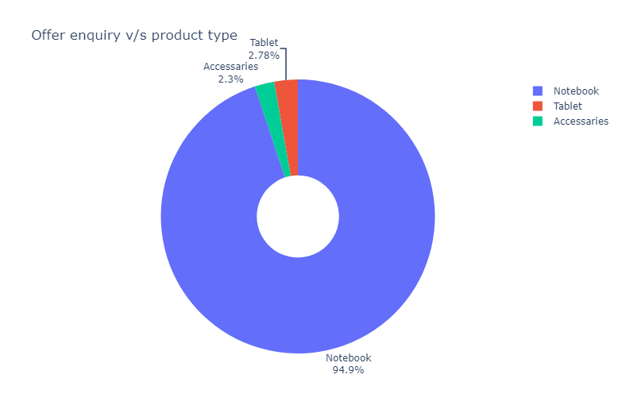
EXPLORATORY DATA ANALYSIS
92% of the calls received related to offer enquiries are for the product Notebook.

Slide 17
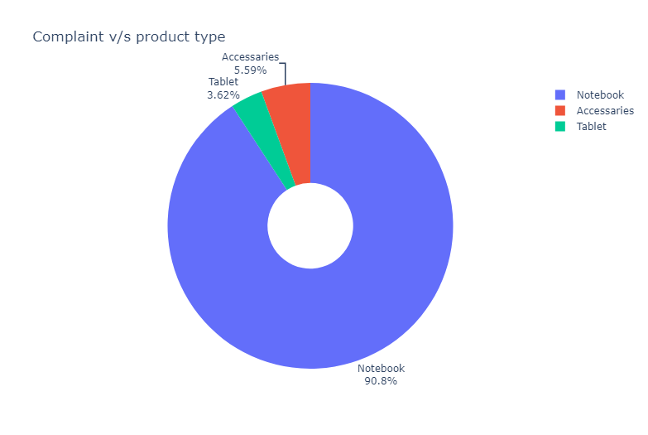
EXPLORATORY DATA ANALYSIS
~88% of the calls received to inform the Complaints are for the product Notebook.
~3.6% of the calls received to inform the Complaints are for the product Tablet.

Slide 18
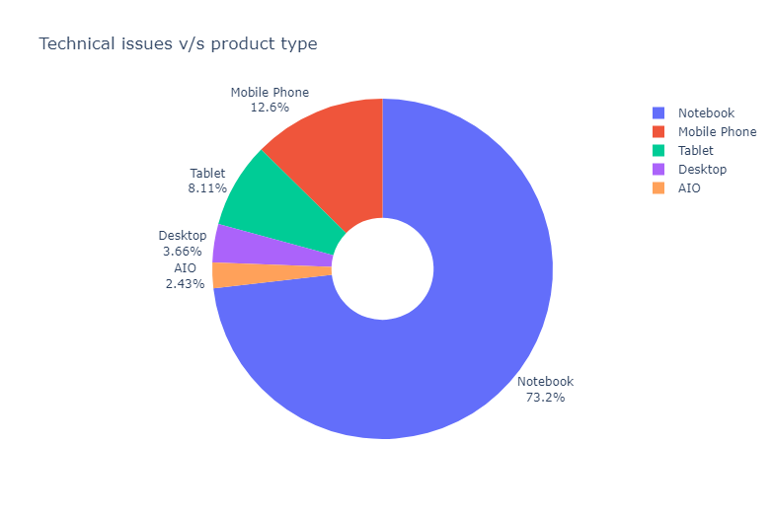
EXPLORATORY DATA ANALYSIS
~73.2% of the calls received to inform the Technical issues are for the product Notebook.
~12% of the calls received to inform the Technical issues are for the product Mobile Phone
~8% of the calls received to inform the Technical issues are for the product Tablet

Slide 19
Conclusion and Recommendations
Causes of customer calls
Customer enquiry calls from Existing Customers/ existing our product users
22% of the customer enquiry calls to inform Complaints related to our products.
~11% of the customer enquiry calls related to Technical Issues of our products
~9% of the customers are facing heating issues in our product
Approximately 42% of the call are from existing customers → Focus on this customers to improve the brand value and reputation.
Enquiry Calls from Potential new buyers
22% of the customer enquiry calls related to Offer Enquiry
16% of the customer enquiry calls related to Product Specs Enquiry
~4.5% of the customer enquiry calls related to Price Enquiry of our products
~ Approximately 93% of the customer enquiry calls are received related to the products "Notebook, Mobile Phone and Tablet"
Approximately 42.5% of the call are from potential new buyers → We can push more promotional offers to this this cluster of people to improve the sales

Slide 20
Conclusion and Recommendations
Recommendations on reducing call volumes
Existing Customers
26.21% of the customer calls are received for the overheating issue of the product Mobile phone → We have to make initiative to reduce the overheating issues in our product Mobile Phone
~15% of the customer calls are received for the overheating issue of the product Tablet→ We have to make initiative to reduce the overheating issues in our product Tablet.
~17% of the customer calls are received for the Technical issue of the product Tablet→ Customers are facing various technical issues in our products→ Make sure good testing before selling the product, best technical support for post sale services
~15% of the customer calls are received for the various complaint of the product Tablet
~88% of the calls received to inform the Complaints are for the product Notebook

Slide 21
Conclusion and Recommendations
Recommendations on reducing call volumes
~73.2% of the calls received to inform the Technical issues are for the product Notebook. →
~12% of the calls received to inform the Technical issues are for the product Mobile Phone .
~8% of the calls received to inform the Technical issues are for the product Tablet
Make sure to implement more standardized methods to reduce the technical issues in across our products.
Potential New Buyers
92% of the calls received related to offer enquiries are for the product Notebook → Lenovo Notebook are the most demanding product → Can classify this type of calls +ve class → offer enquiry calls can generate revenues, because they can be potential buyers

Slide 22
Conclusion and Recommendations
Handling calls better to increase customer sales.
~9% of the customer enquiry calls are not resolved in the first attempt due to Call Disconnected → Reduce this call dropping rate to improve customer satisfaction → This may lead to more brand value and sales
May classify as Potential new buyers / new customers
22% of the customer enquiry calls related to Offer Enquiry → Potential buyers → Can push Targeted advertising to this cluster.
16% of the customer enquiry calls related to Product Specs Enquiry → Potential buyers → Can push Targeted advertising to this cluster
~4.5% of the customer enquiry calls related to Price Enquiry → Can give more offers if applicable
Approximately 42.5% of the call are from potential new customers. We can push more promotional users to this cluster of people to improve the sales
`57%` of the customer enquiry calls are received from the `age group 22-30` → They are potential buyers we can give more offers to this user group.

Slide 23
Conclusion and Recommendations
I analysed customer enquiry calls related to our products and found that the most common reasons for calls are complaints, technical issues, and heating issues.
Additionally, I found that the majority of calls are from existing customers, but there is still a significant number of calls from potential new customers.
Causes of customer calls:
22% of calls are related to complaints
11% of calls are related to technical issues (specifically for mobile phones)
9% of calls are related to heating issues
22% of calls are related to offer enquiries
16% of calls are related to product specs enquiries
4.5% of calls are related to price enquiries
Recommendations for reducing call volumes:
Address the most common issues (complaints and technical issues) to reduce the number of calls related to those topics
Increase the visibility and accessibility of information on the website to reduce the number of calls related to offer enquiries, product specs enquiries, and price enquiries.
Improve the design of the product to address the technical issues that customers are facing and reduce the number of calls.

Slide 24
Conclusion and Recommendations
Handling calls better to increase customer sales:
Resolve customer issues on the first call to prevent repeat calls and increase customer satisfaction
Understand the customer's needs and tailor the sales pitch accordingly.
Identify the most common reasons for calls and develop specific training for customer service representatives to handle those calls more effectively
Develop a way of capturing customer complaints and feedback and act on it.
Target promotions to potential new customers and existing customers separately.
Look into the customer's usage of the product, their age group, their occupation, and target them accordingly.
Conclusion:
By understanding the causes of customer calls, we can take steps to reduce the number of calls and increase customer satisfaction and sales. By addressing common issues, improving the design of our products, and targeting promotions and sales efforts to specific customer segments, we can improve our customer service and increase sales.

